Slide 1

HR Analytics Dashboard
Dr. Rakhee Chhibber

Slide 2
Steps to Build a complete interactive dash board
Load data
Transform Data
Clean Data
  Quality check for Finding missing or null values
  Remove Duplicates
  Remove inconsistencies
Designing the DashBoard
  Design a header
  Design logo
  Design KPIS
  Desgin charts
  Add a slicer for interactive dashboard

Slide 3
Step 1 & 2

Slide 4
Step 1 & 2 - Load and transform data
Select any of the file which contains data
Now, Transform the data to change any data types size etc.

Slide 5
Step – 3
Quality Check for finding missing values, Duplicate values and removal of inconsistencies

Slide 6
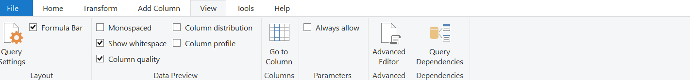
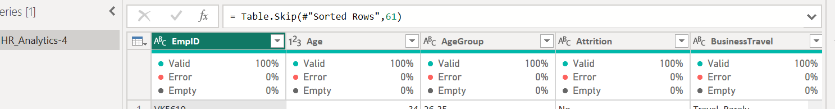
1. Quality Check for data to find missing value and delete them
Go in transform
Select one or all columns
Select view and column Quality Check Box

Slide 7
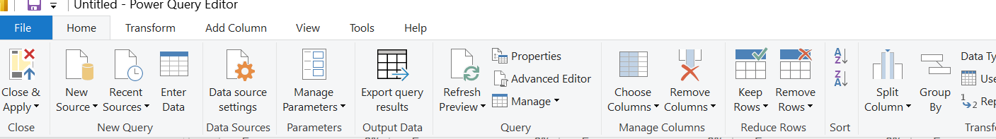
If we find empty % not 0 then we can clean column by removing the null values
Select the column → Right Click → sort Ascending → check the row numbers till it is showing null
Go on home tab of transform data → select remove rows → remove top rows and specify the row numbers till it is blank for example – 10, 20 or so

Slide 8
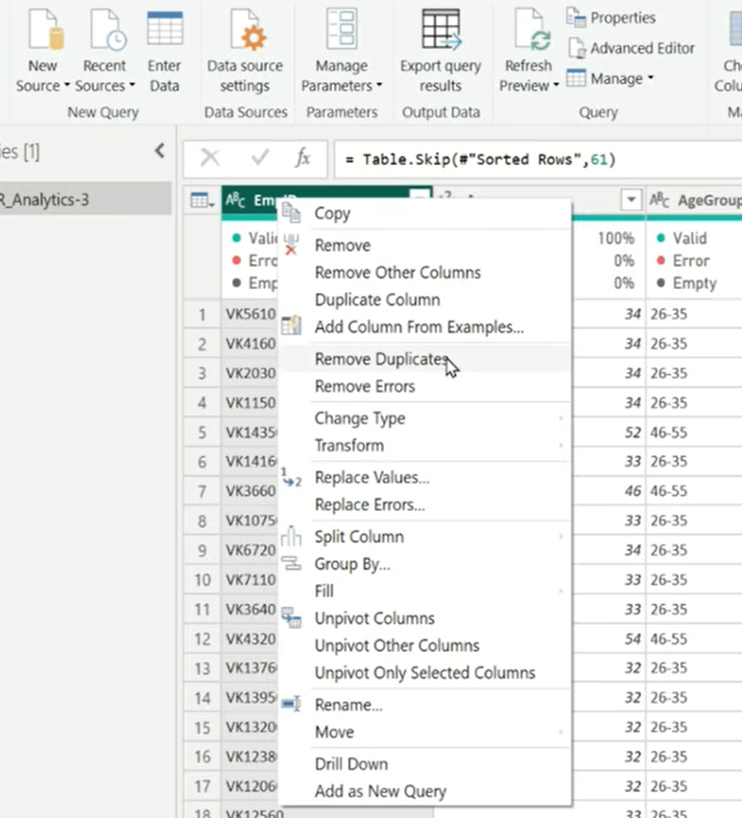
Remove Duplicate
Select any column → right click → Remove Duplicates
But it may possible there are different month or year of data so for that to check complete duplicity.

Slide 9
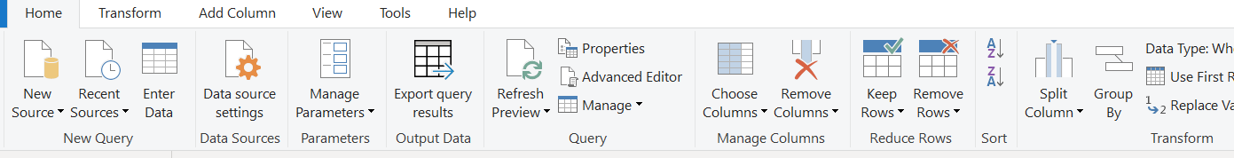
Check for duplicate using all columns
Before removing all duplicates we have to check.
Select employee id → home tab in transform data → select group by

Slide 10
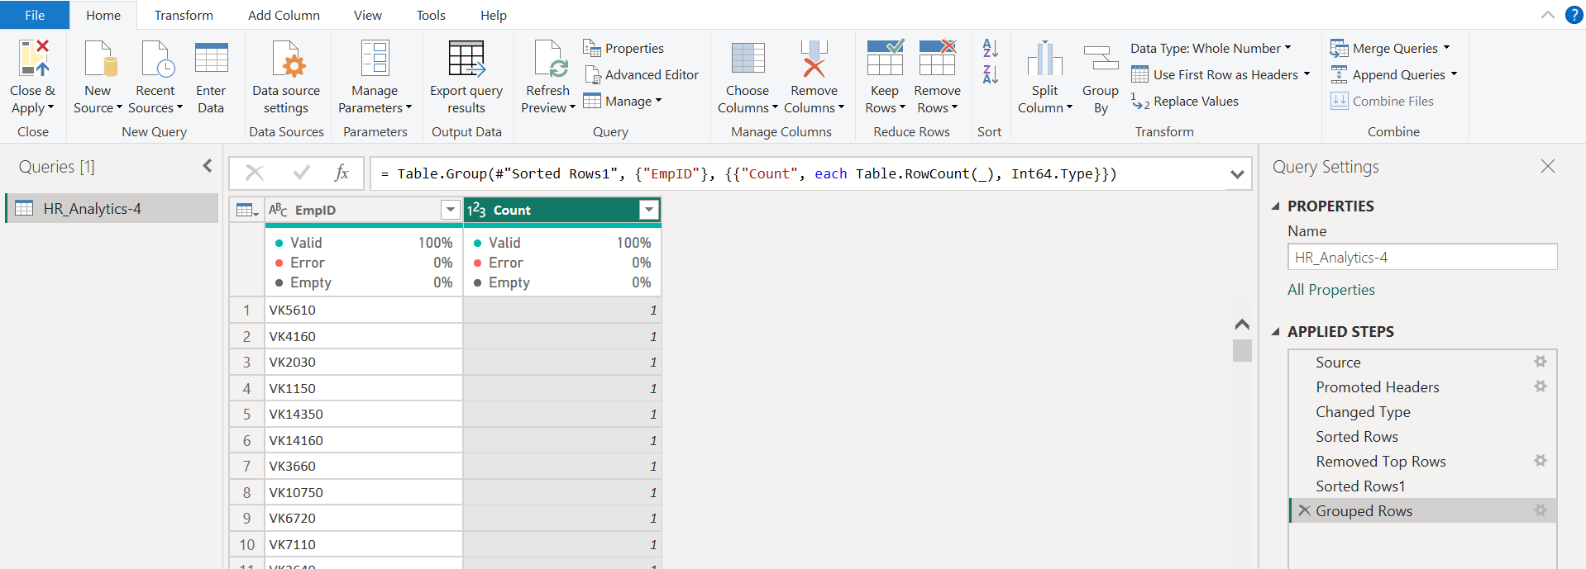

Slide 11
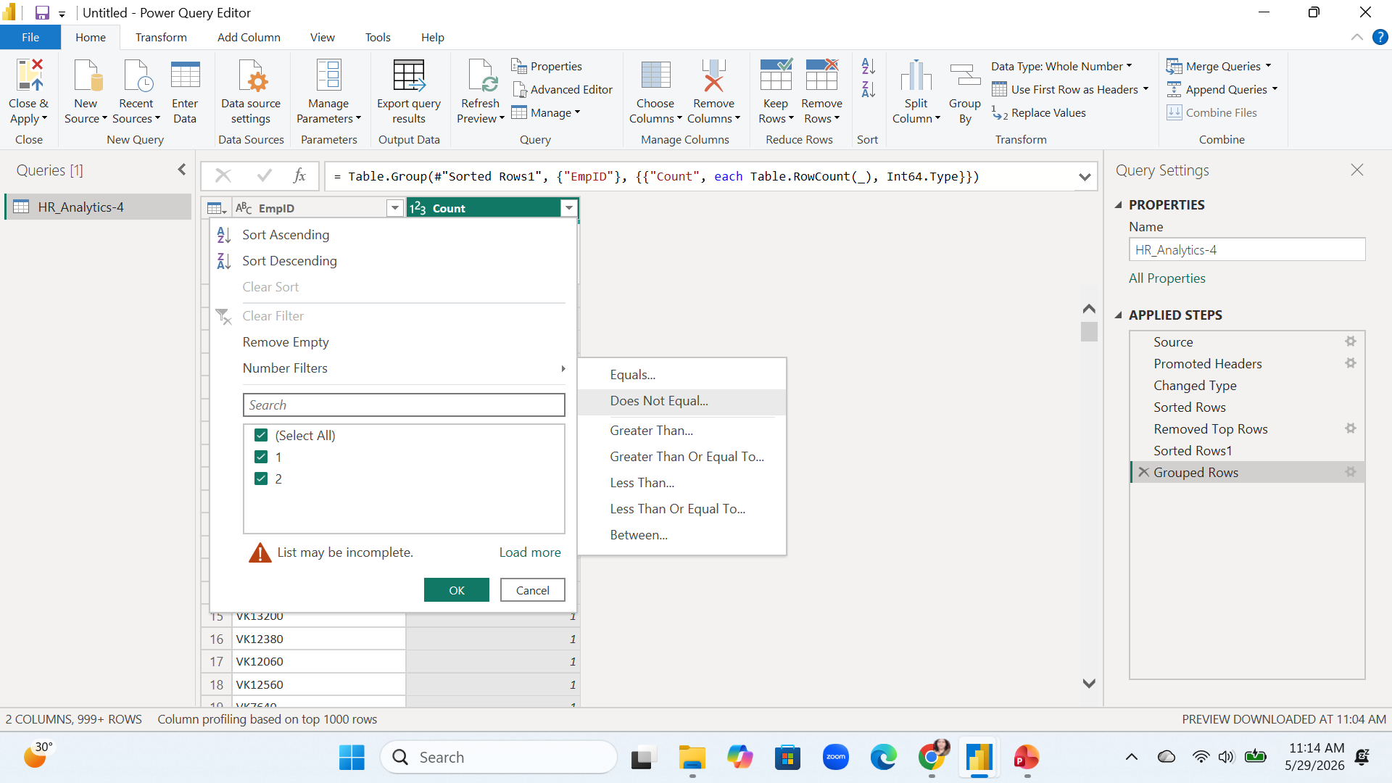

Slide 12
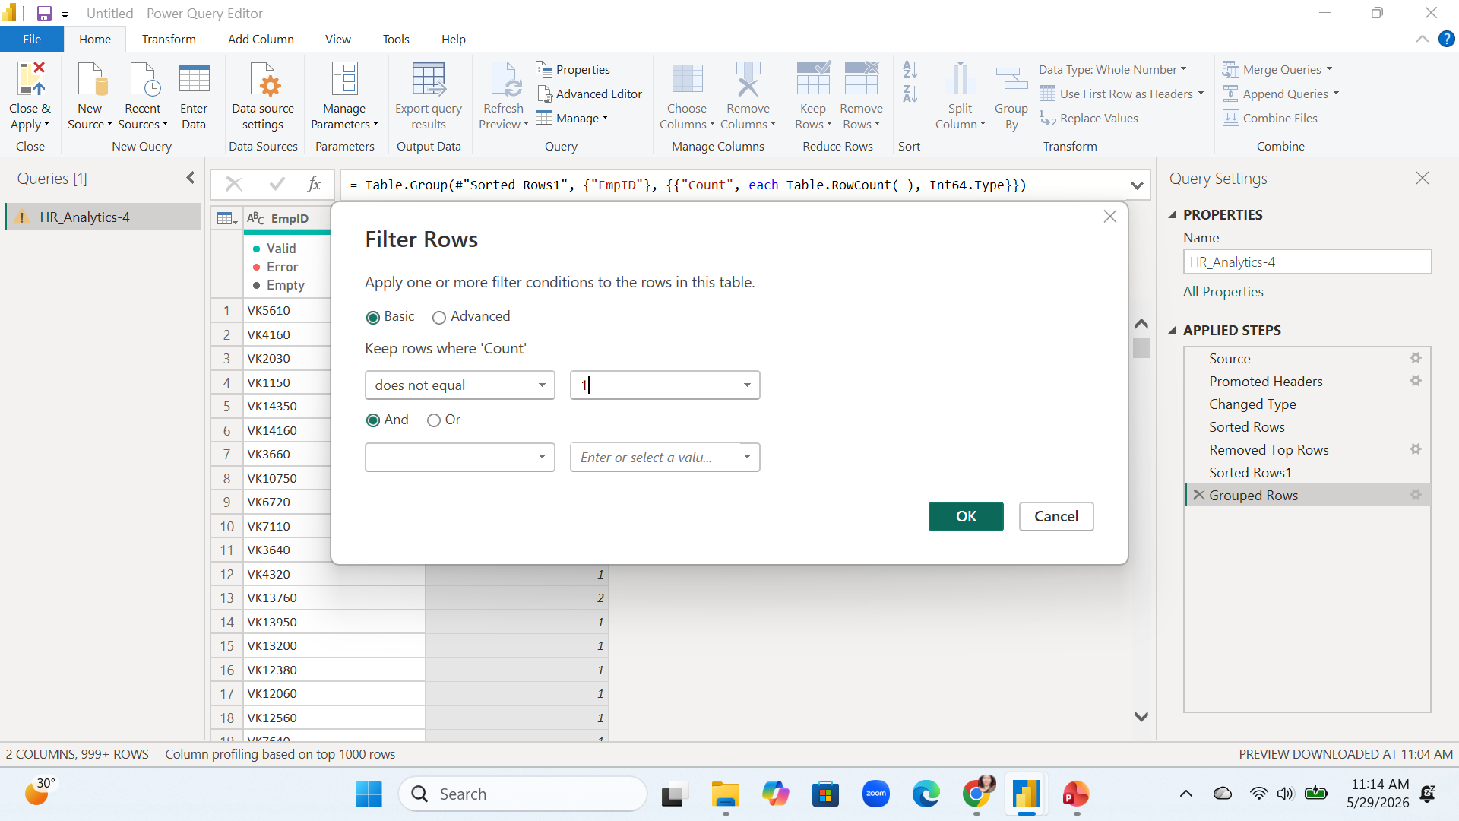

Slide 13
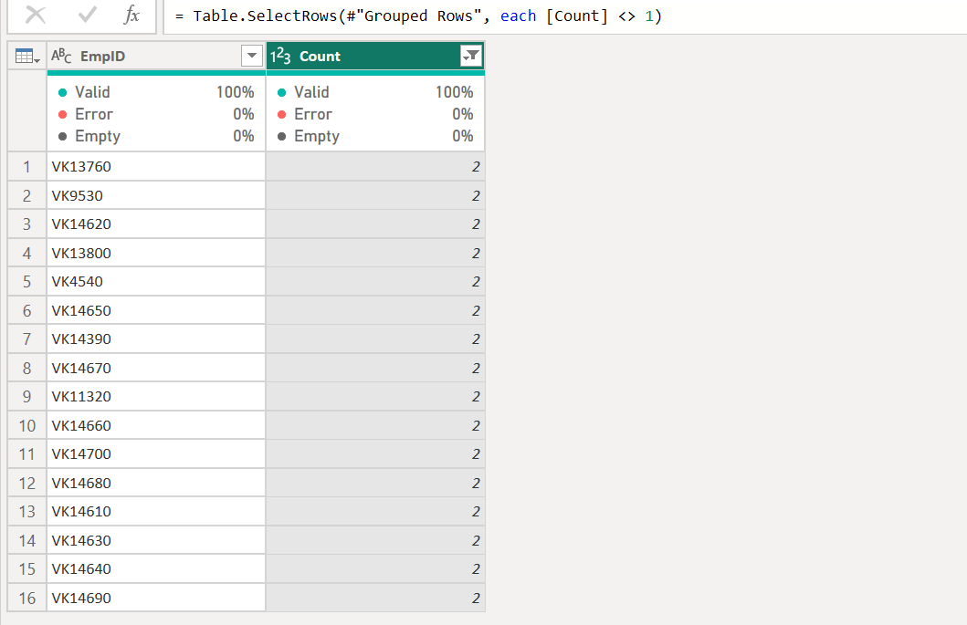

Slide 14
Now remove filter and group by from query settings to get whole data.
Select all columns and right click on any column → remove duplicates
Now our dataset is clean

Slide 15
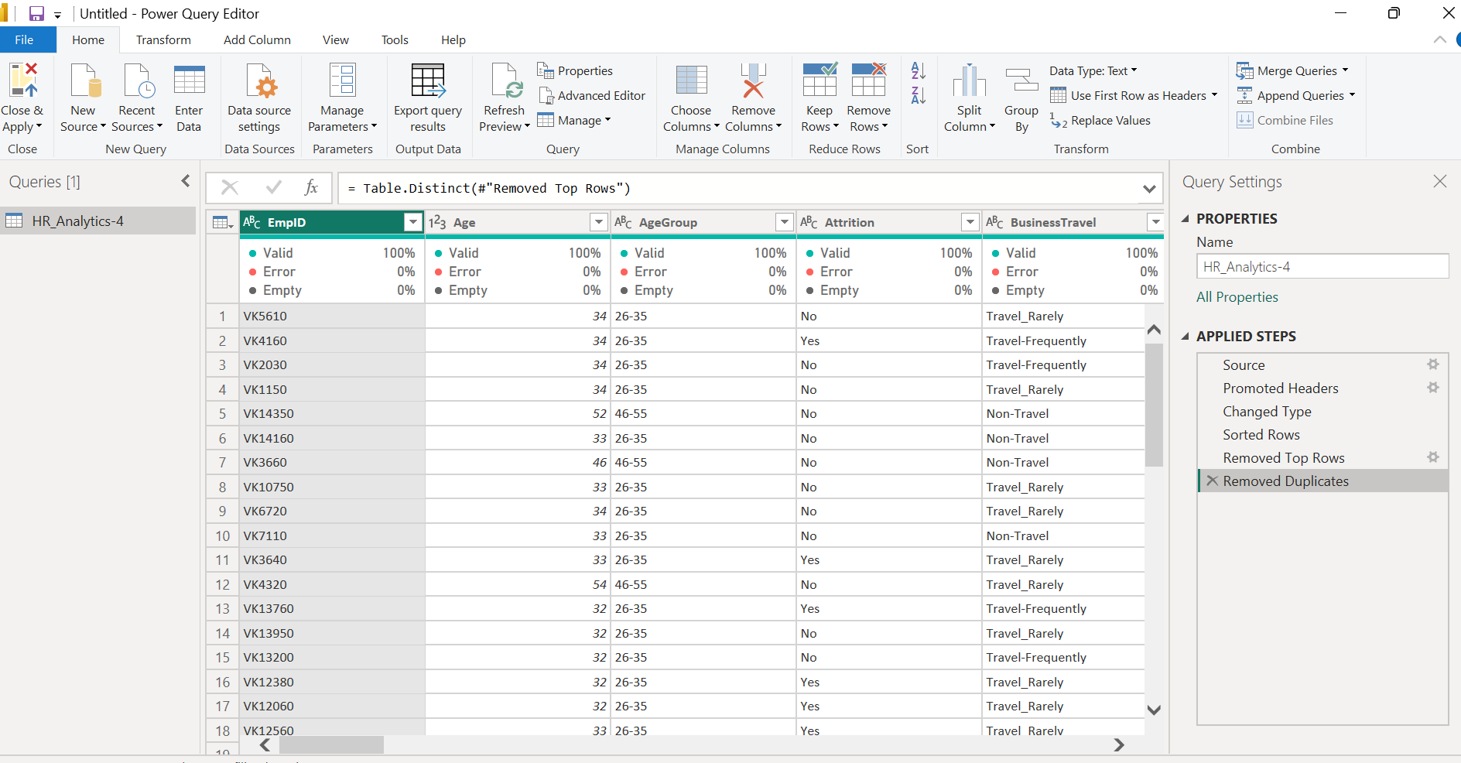

Slide 16
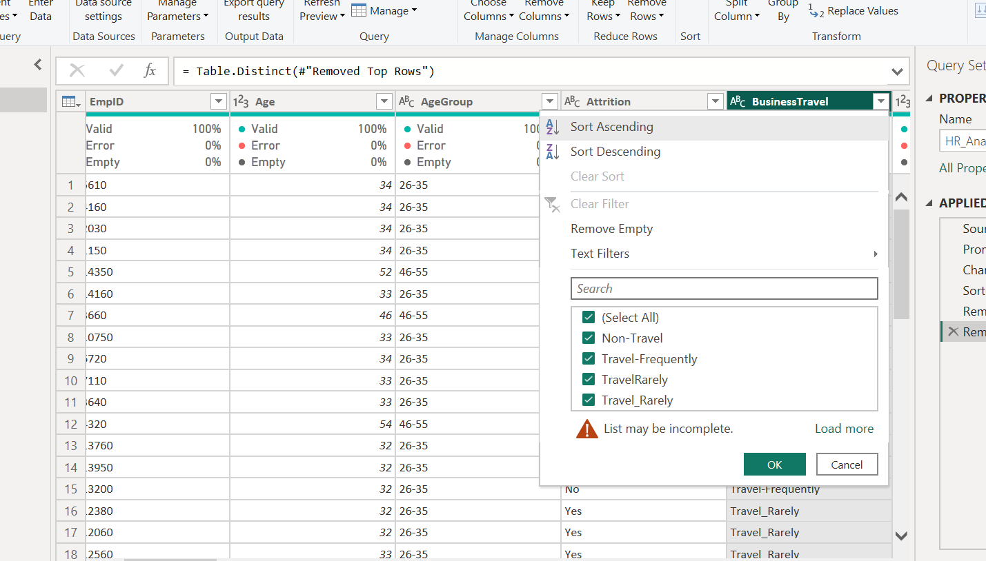
Remove inconsistency
For example – in business travel we have 2 values
TravelRarely and Travel_Rarely
Both are same so we can find all these values and replace with one value

Slide 17
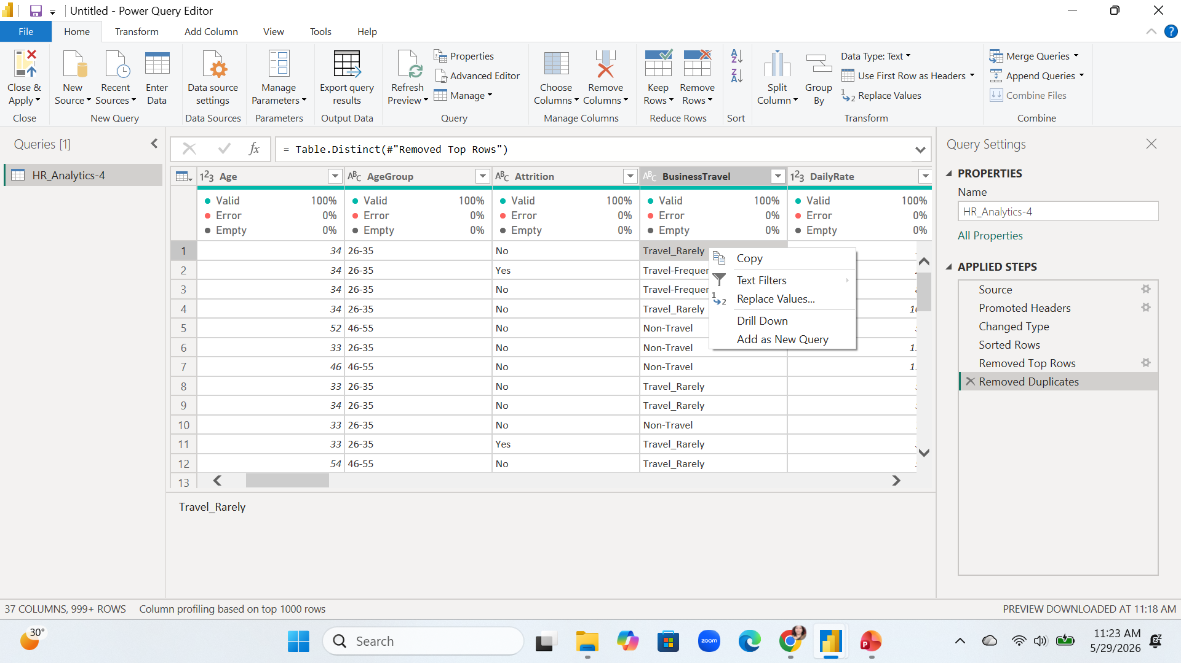
Solution
Select the column value → right click → select replace value and give TravelRarely
Now select close and apply to apply all transformation in dataset

Slide 18
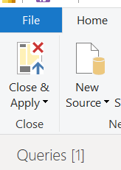
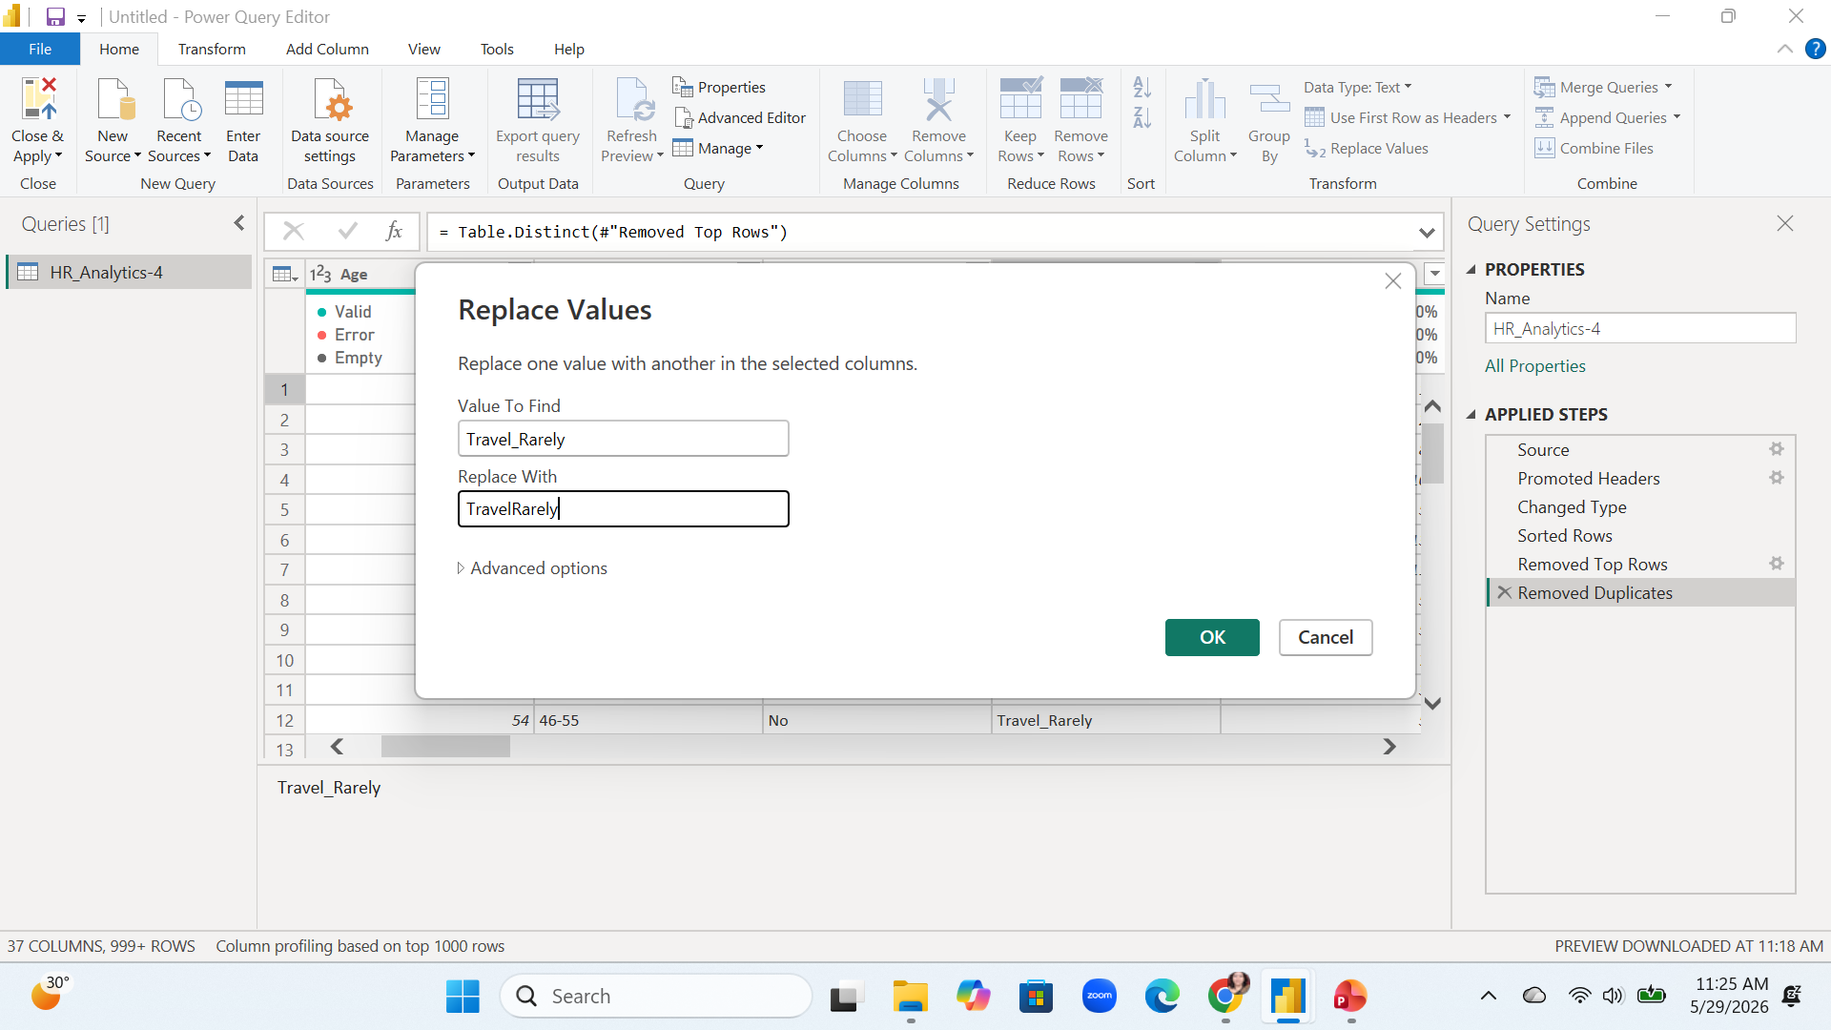

Slide 19
Design the DashBoard

Slide 20
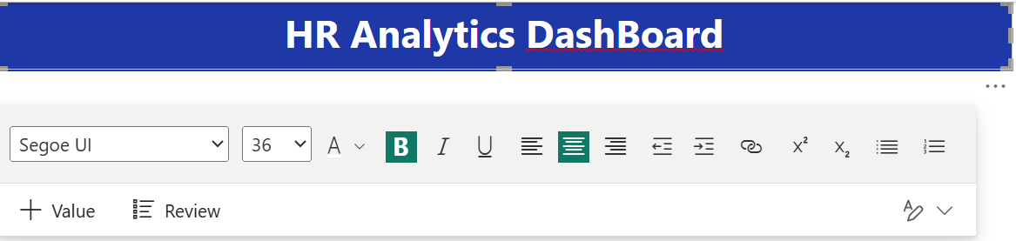
Step 4 - Design The DashBoard
Select page 1 → insert → text Box for header
Set its properties
  Height – 85
  Width – 1259
Select effect
  Background color - #1F38A8 for professional look
Select Text font size 36 and color white
If you have any logo can insert as image and place it on header of page

Slide 21
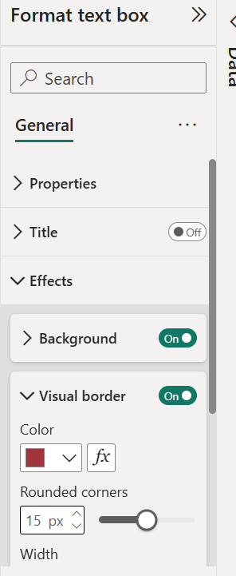
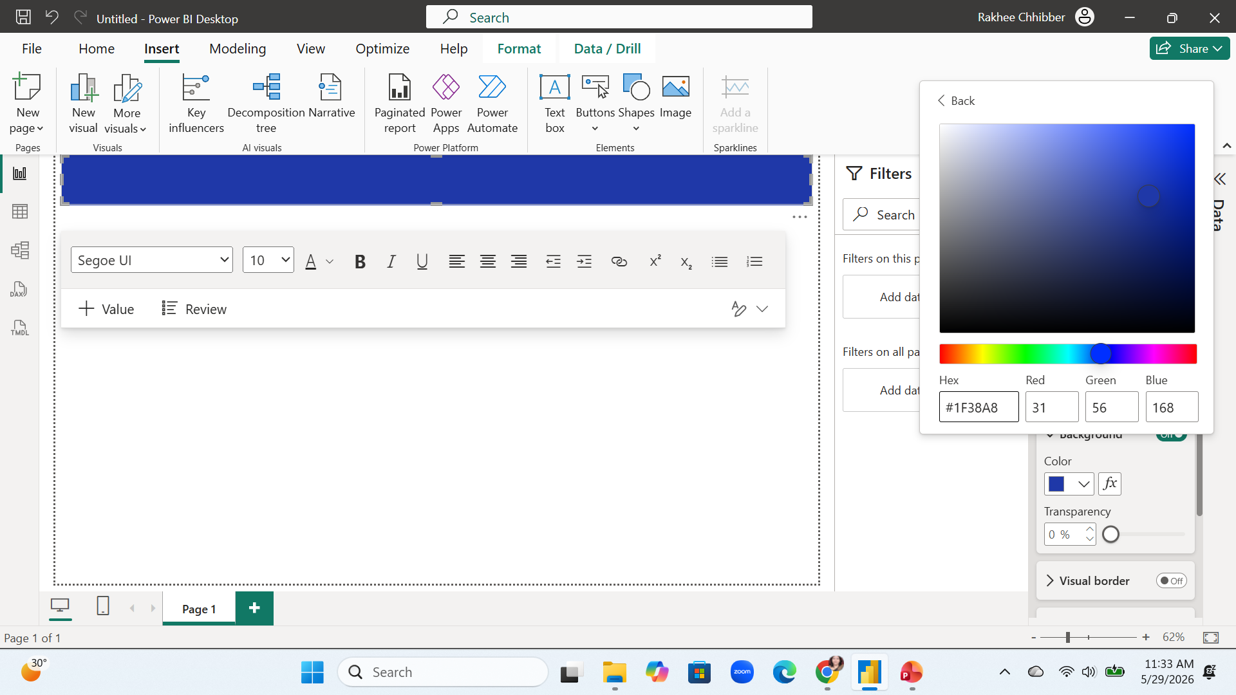

Slide 22
Add KPI’s
KPI 1. No of employees
  Select card → add count on employeeid as value
  Formatting of card
  Format pane →
  general →
    size → Height = 104 width = 197
    Position → horizontal =12 vertical =110
    Title – on, Font → 20, Bold, Horizontal Alignment → center
    Visual Baord → select color, rounded corner → 12 px
    Select shadow on and select the color of shadow
  Visual →
    Callout → turn off Label
Create 5 more KPI ‘s by using ctrl+c and ctrl +v so formatting for all KPI cards will be remain same

Slide 23
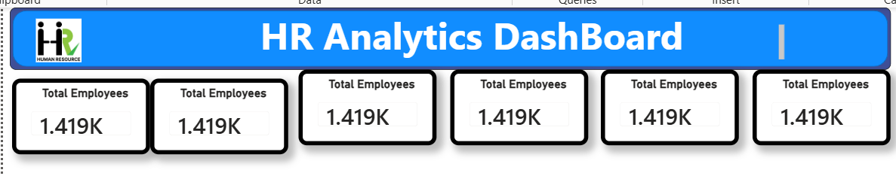
Set The formatting properties for all KPI’s so all will looks same

Slide 24
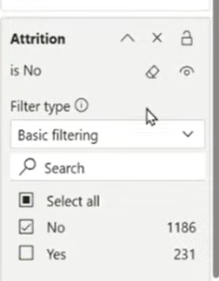
KPI 2 – Active Employee
Select 2nd card and set properties
  Add value – count on empId
  Filter of attrition and select no to see only active employees
  Format pane →
  general →
    size → Height = 104 width = 197
    Position → horizontal =12 vertical =110
    Title – on, Font → 20, Bold, Horizontal Alignment → center
    Visual Baord → select color, rounded corner → 12 px
    Select shadow on and select the color of shadow
  Visual →
    Callout → turn off Label
  General → title → Active Employees

Slide 25
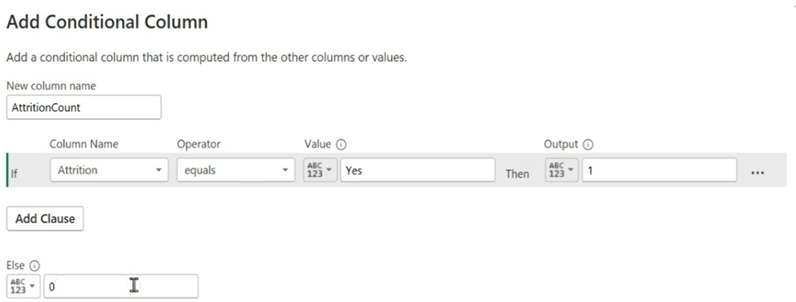
KPI 3 – Attrition Count → add a new column and do the conditional formatting as given below
Goto Transform Data → add Column → select conditional column
Select the data type as whole number
Set all the formating properties as the above KPIs

Slide 26
KPI 4- Attrition Rate
Create a new measure
  Attrition Rate % = DIVIDE(sum('HR_Analytics-4'[Count Atrition]),sum('HR_Analytics-4'[EmployeeCount]),0)
Add this measure on 4th KPI card and do the formatting

Slide 27
KPI 5 – Average Age
KPI 5 card → drag the age column and set as average age

Slide 28
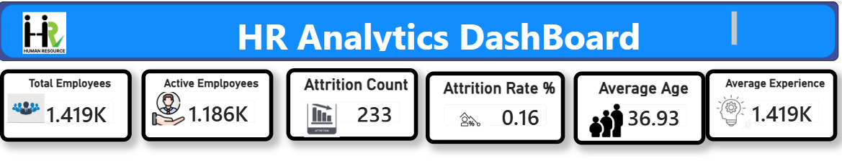
KPI 6 – Average Experience
Select a card and → age as value and select average
Add icon images also.
Insert → image and upload image → do it for all icons and adjust them with the KPI cards

Slide 29
Add Charts

Slide 30
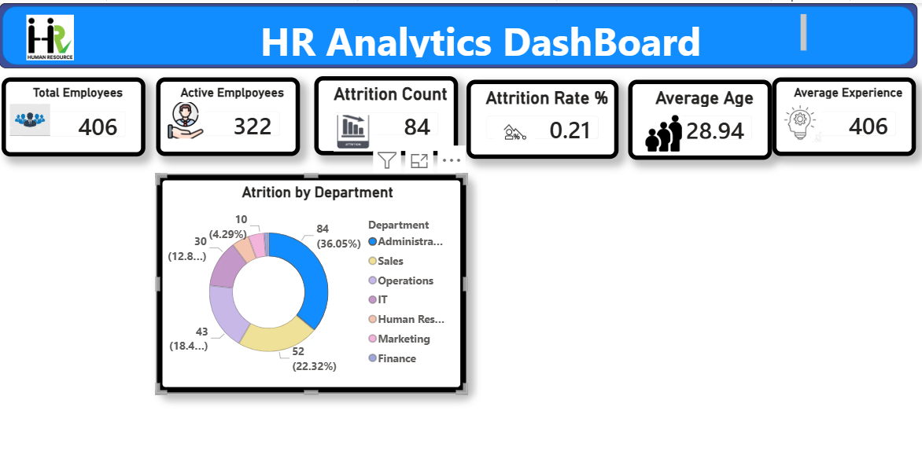
Attrition by Department
Add a Donut Chart
Legend→ Department
Values → count Attrition
Format the chart through formatting panel

Slide 31
Add chart as Attrition By Salary Slab
Cluster bar chart
  Y-Axis → SalarySlab
  X-Axis → sumof EmployeeCount
  Legend → Attrition
Add formatting
  General → height, width,
  Effects → border width, rounded corner etc

Slide 32
Add matrix
Set Values as →
  Rows→ job role
  Columns → job satisfaction
  Values → sum of count Attrition
Sets formatting from format pane
  Row headers → bold
  Column Headers → bold

Slide 33
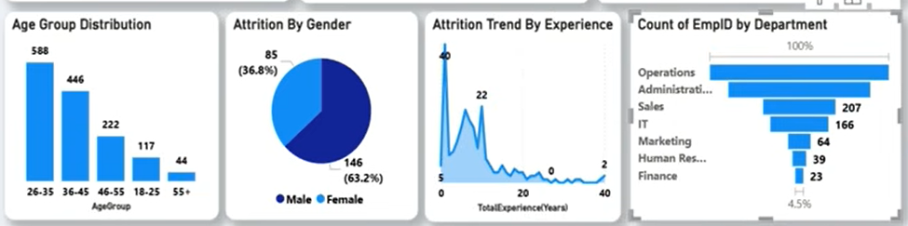
Add some more charts like
X axis – age Group Y Axis – count of emp id | Legend → Gender Values → Count of EMpID | Area chart X-axis → total years of experience Yaxis → Sum of Count Attrition | Funnel Chart Category → Department Values → Count of EMPID

Slide 34
Create A slicer
TO make it interactive with department add a slicer
Slicer setting → tiles
Set the background color

Slide 35
